Slide 1
Blind Test Healthy vs Breast Cancer Plasma Samples based on Exosome count using PANORAMA

Slide 2
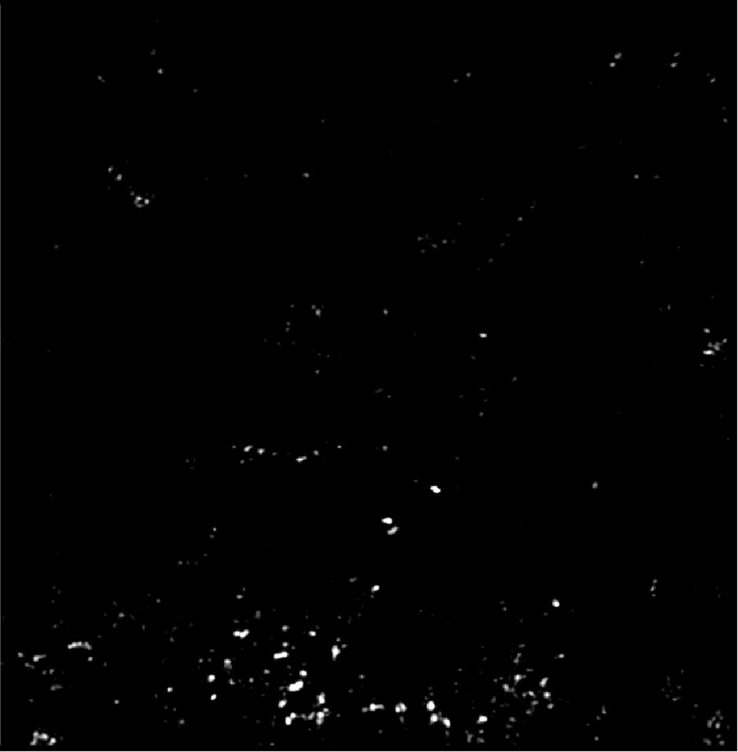
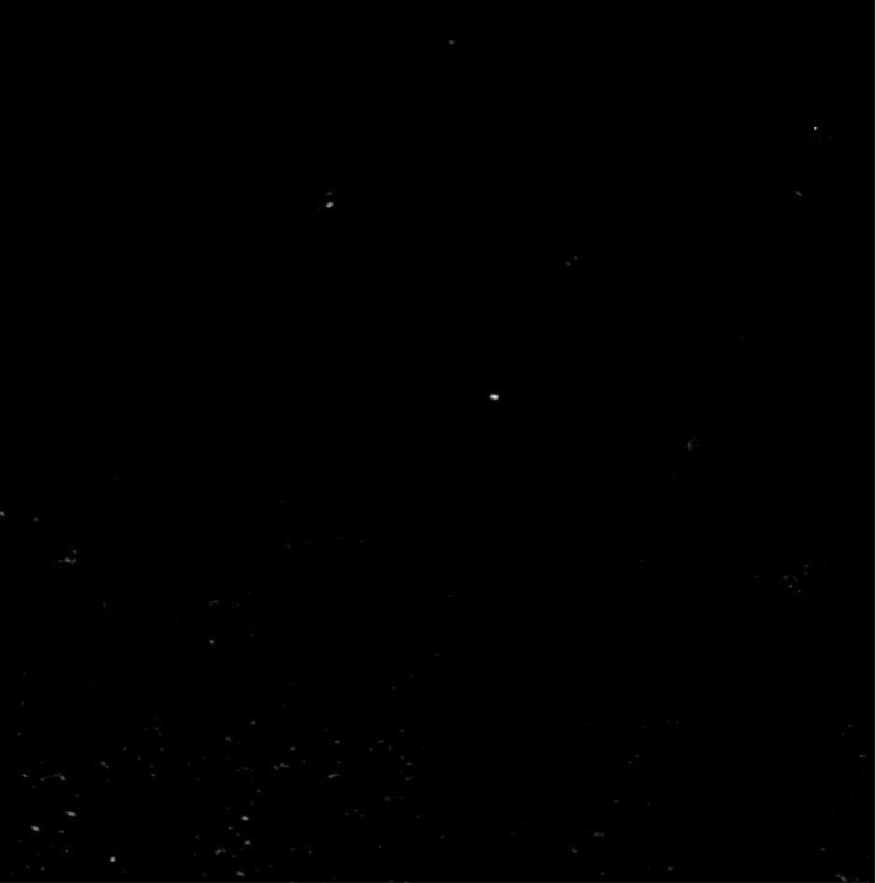
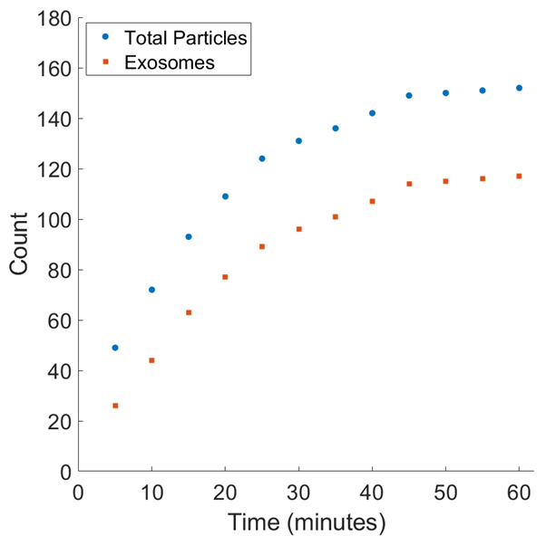
PANORAMA of Plasma Sample 52 (Prediction: Healthy)
Time: 60 min
Count: 152 (Ex: 117; Large: 35)
Time: 60 min wash
Count: 11
Based On Count: Before wash count matches CI Healthy (64-172)
After wash count matches 99% CI Healthy (5-28)
Note: 0 % response to miRNA-21
Looks Healthy
Scale Bar: 10 µm

Slide 3
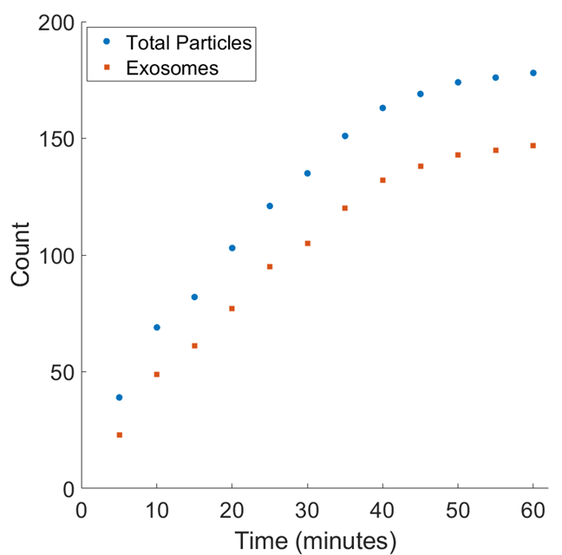
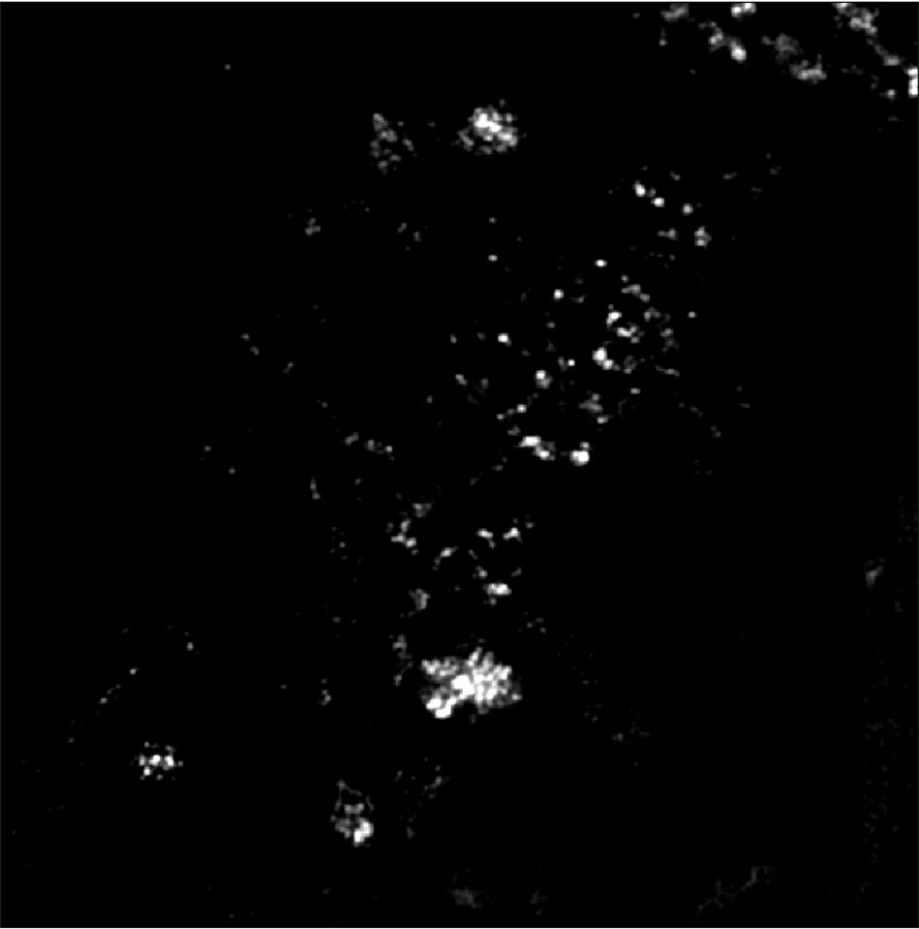
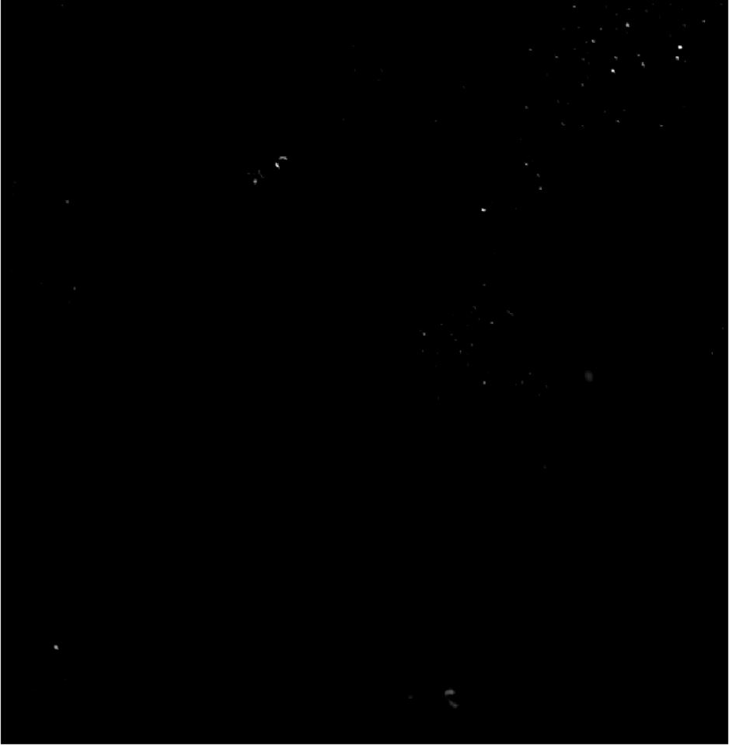
PANORAMA of Plasma Sample 53 (Prediction: Healthy)
Time: 60 min
Count: 178 (Ex: 147; Large: 31)
Time: 60 min wash
Count: 27
Based On Count: Before wash count higher than CI Healthy (64-172)
After wash count matches 99% CI Healthy (5-28)
Note: 0 % response to miRNA-21
Looks Healthy
Scale Bar: 10 µm

Slide 4


PANORAMA of Plasma Sample 54 (Prediction: Healthy)
Time: 60 min
Count: 216 (Ex: 168; Large: 48)
Time: 60 min wash
Count: 45
Based On Count: Before wash count higher than CI Healthy (64-172)
After wash count higher than 99% CI Healthy (5-28) but lower than 70
Note: 0 % response to miRNA-21
Look healthy
Scale Bar: 10 µm

Slide 5
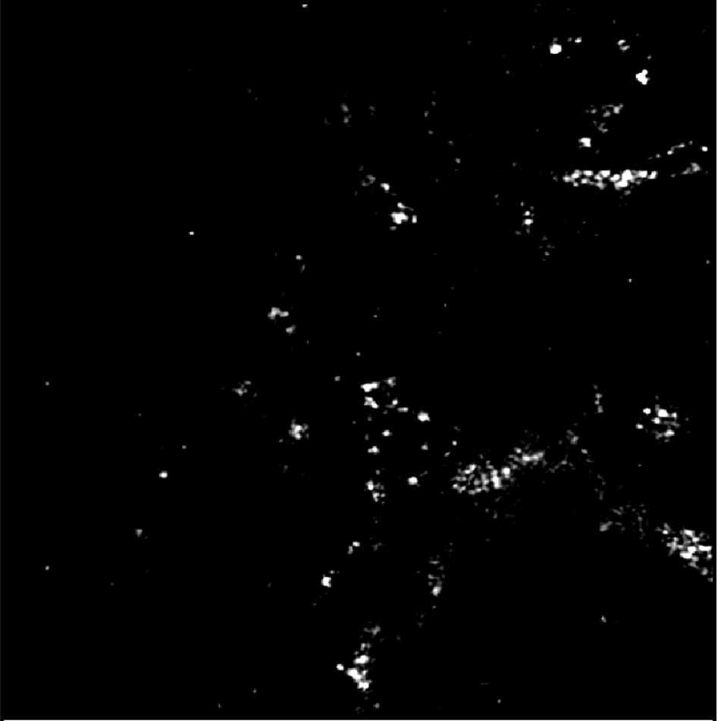
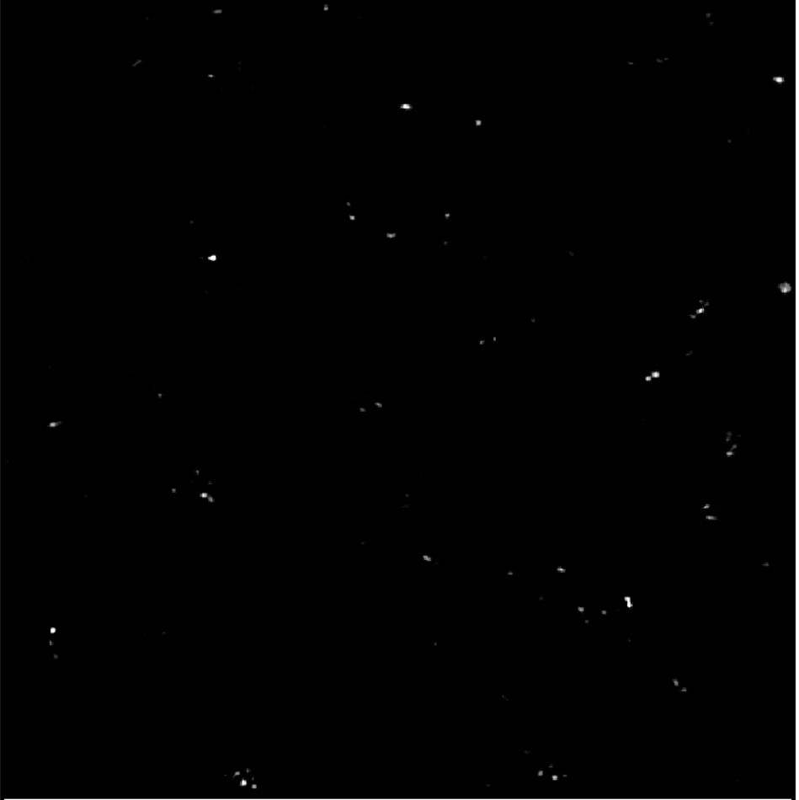
PANORAMA of Plasma Sample 55 (Prediction: Healthy)
Time: 60 min
Count: 236 (Ex: 159; Large: 77)
Time: 60 min wash
Count: 49
Based On Count: Before wash count higher than CI Healthy (64-172)
After wash count higher than 99% CI Healthy (5-28) but lower than 70
Note: 0 % response to miRNA-21
Look healthy
Scale Bar: 10 µm

Slide 6
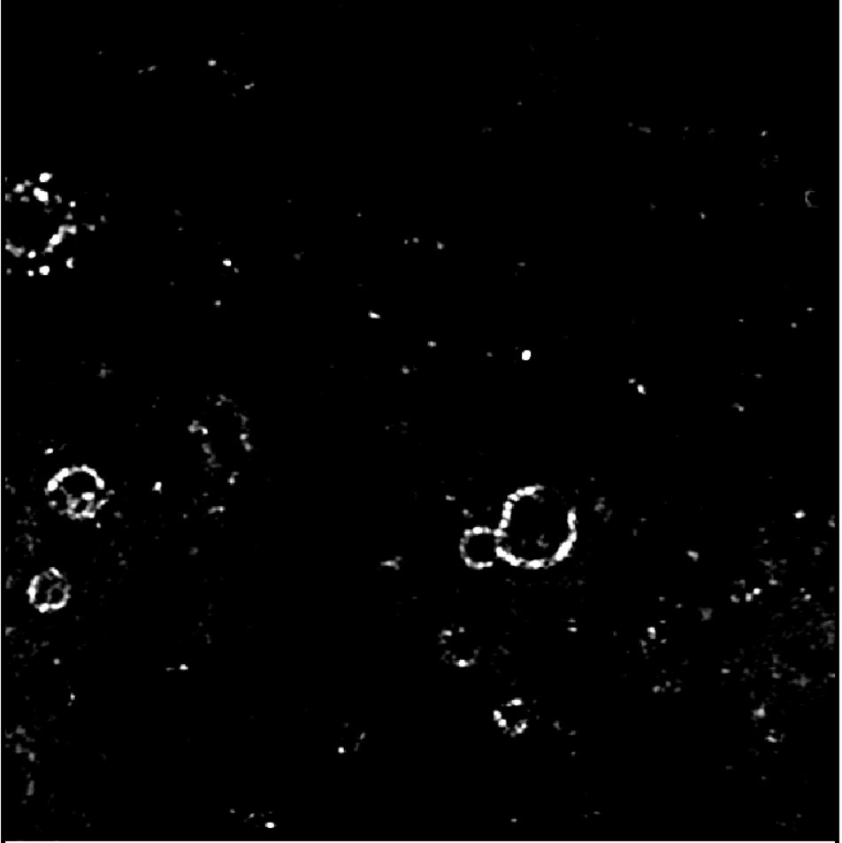

PANORAMA of Plasma Sample 56 (Prediction: Healthy)
Time: 60 min
Count: 194 (Ex: 162; Large: 32)
Time: 60 min wash
Count: 59
Based On Count: Before wash count higher than CI Healthy (64-172)
After wash count higher than 99% CI Healthy (5-28) but lower than 70
Note: 0 % response to miRNA-21
Look healthy
Scale Bar: 10 µm

Slide 7
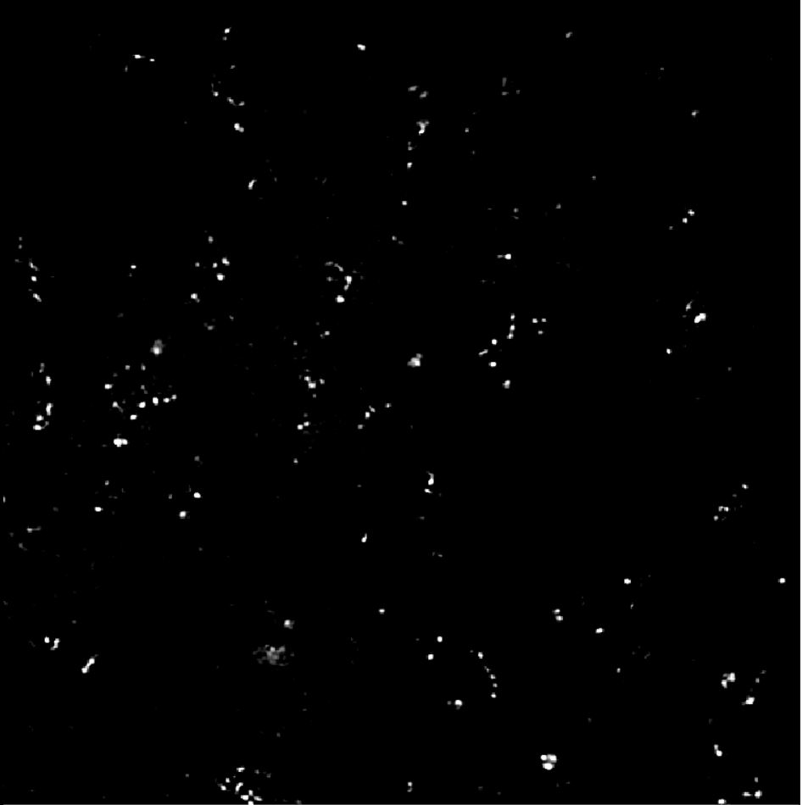

PANORAMA of Plasma Sample 57 (Prediction: Cancer)
Time: 60 min
Count: 325 (Ex: 241; Large: 84)
Time: 60 min wash
Count: 111
Based On Count: Before wash count lower than CI of stage 1 (950-1558)
After wash lower than CI stage 1 (151-370) and significantly
higher than Healthy (5-70)
Note: 11% response to miRNA-21
Look cancerous
Scale Bar: 10 µm

Slide 8
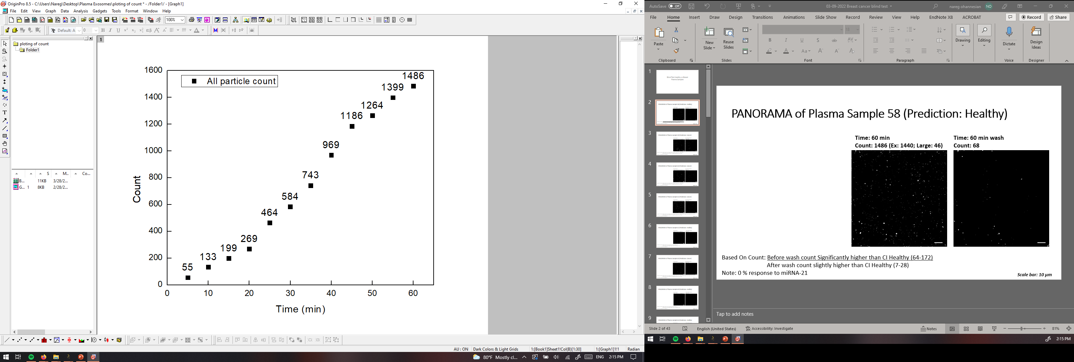
PANORAMA of Plasma Sample 58 (Prediction: Healthy)
Time: 60 min
Count: 1486 (Ex: 1440; Large: 46)
Time: 60 min wash
Count: 68
Based On Count: Before wash count Significantly higher than CI Healthy (64-172)
After wash count slightly higher than CI Healthy (7-28)
Note: 0 % response to miRNA-21
Scale bar: 10 µm

Slide 9
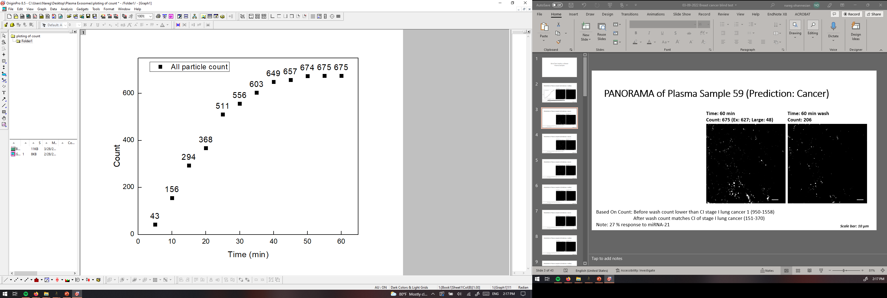
PANORAMA of Plasma Sample 59 (Prediction: Cancer)
Time: 60 min
Count: 675 (Ex: 627; Large: 48)
Time: 60 min wash
Count: 206
Based On Count: Before wash count lower than CI stage I lung cancer 1 (950-1558)
After wash count matches CI of stage I lung cancer (151-370)
Note: 27 % response to miRNA-21
Scale bar: 10 µm

Slide 10
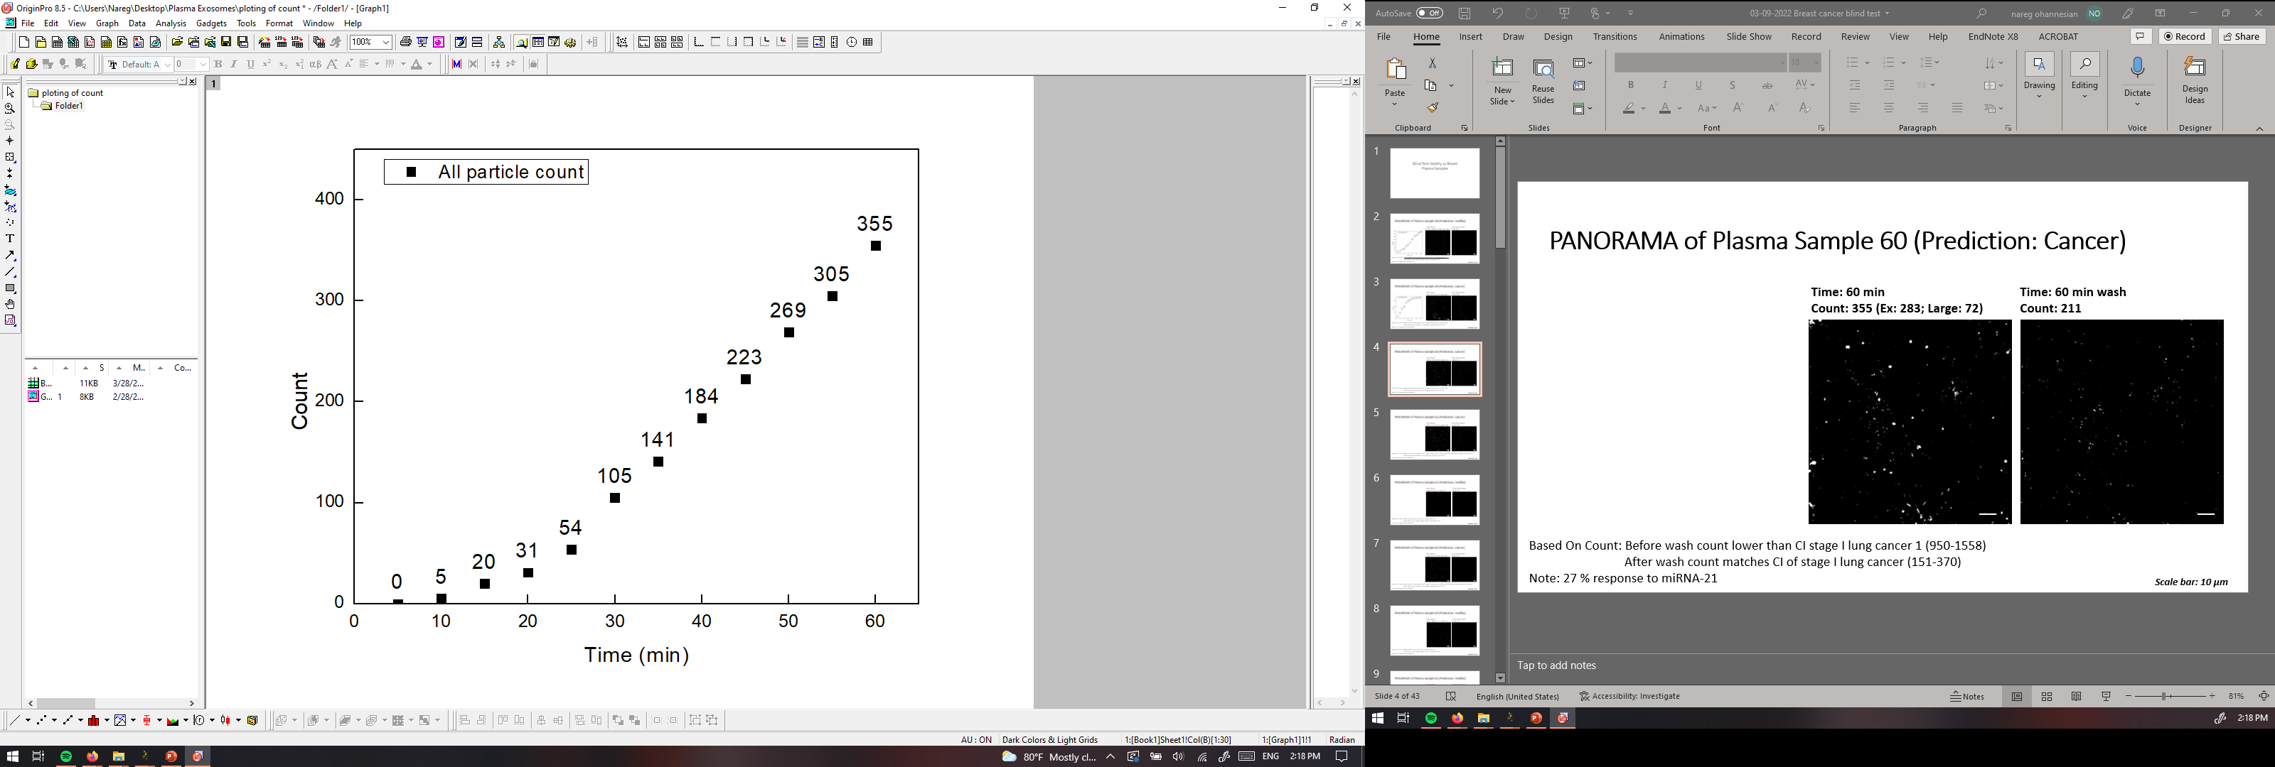

PANORAMA of Plasma Sample 60 (Prediction: Cancer)
Time: 60 min
Count: 355 (Ex: 283; Large: 72)
Time: 60 min wash
Count: 211
Based On Count: Before wash count lower than CI stage I lung cancer 1 (950-1558)
After wash count matches CI of stage I lung cancer (151-370)
Note: 27 % response to miRNA-21
Scale bar: 10 µm

Slide 11



PANORAMA of Plasma Sample 61 (Prediction: Cancer)
Time: 60 min
Count: 713 (Ex: 283; Large: 193)
Time: 60 min wash
Count: 290
Based On Count: Before wash count lower than CI stage I lung cancer 1 (950-1558) but significantly higher than normal
After wash count matches CI of stage I lung cancer (151-370)
Note: 0% response to miRNA-21
Scale bar: 10 µm

Slide 12
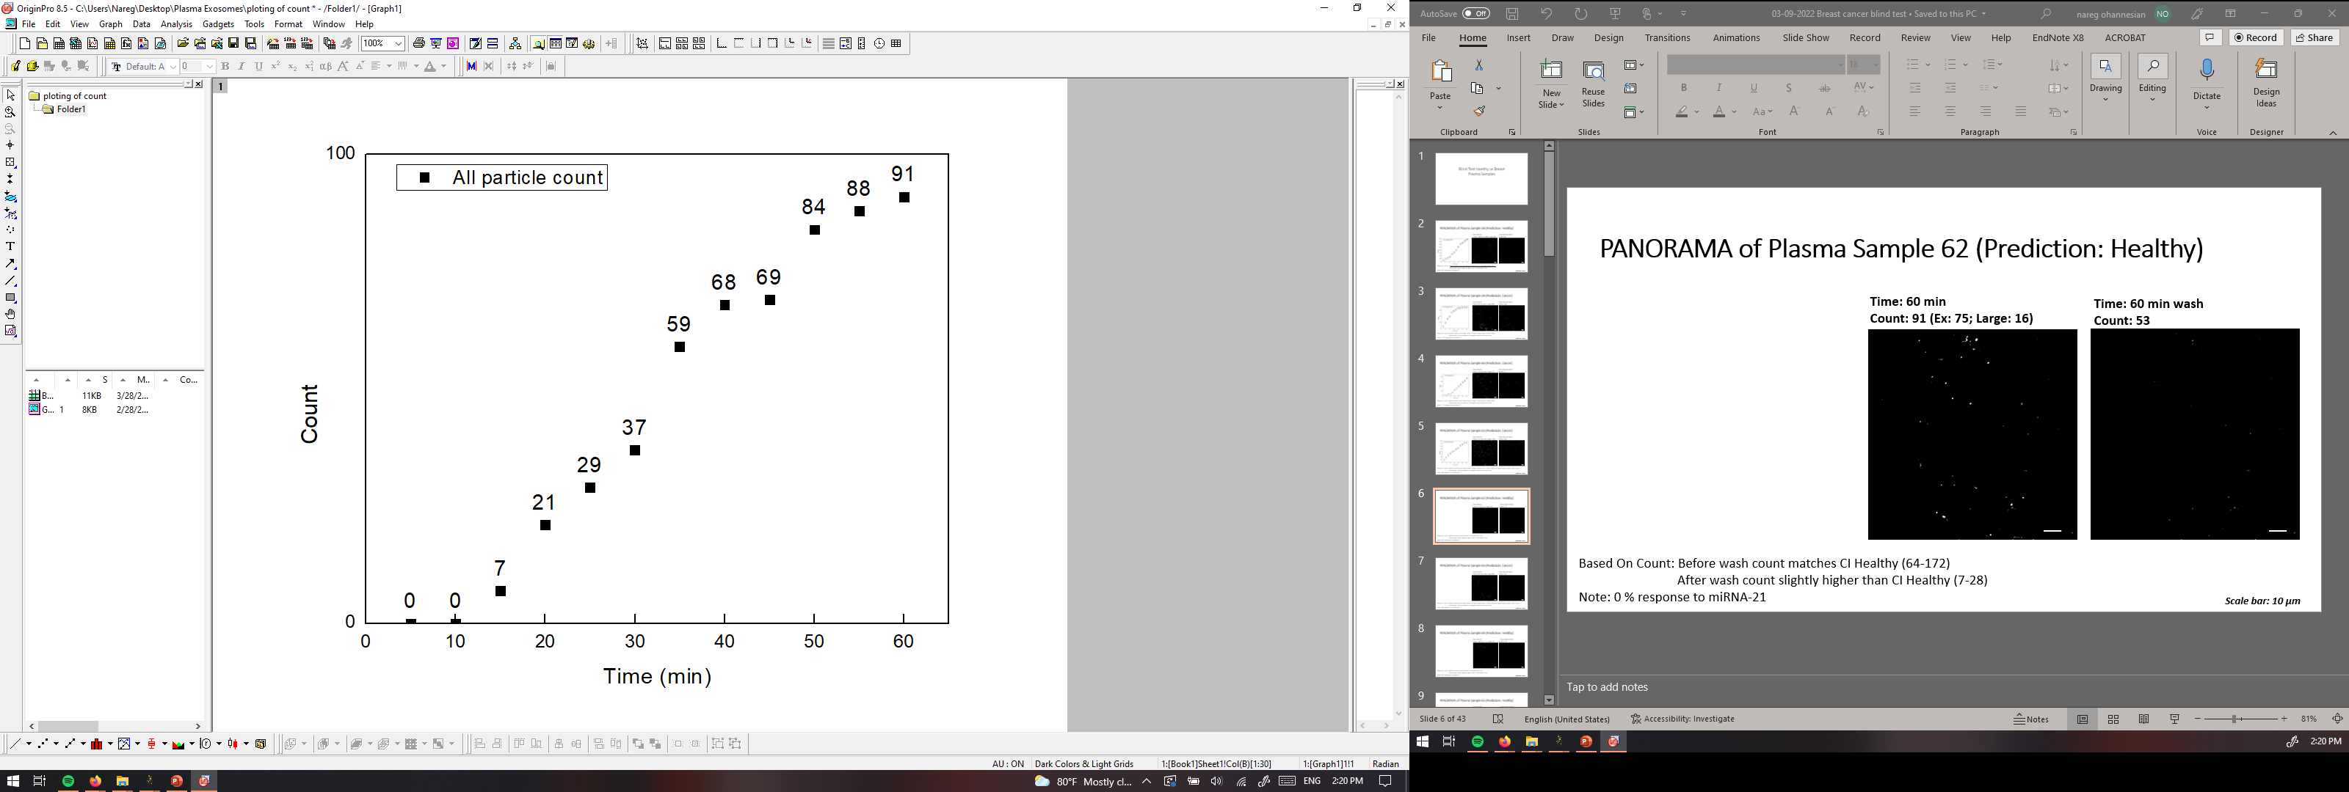
PANORAMA of Plasma Sample 62 (Prediction: Healthy)
Time: 60 min
Count: 91 (Ex: 75; Large: 16)
Time: 60 min wash
Count: 53
Based On Count: Before wash count matches CI Healthy (64-172)
After wash count slightly higher than CI Healthy (7-28)
Note: 0 % response to miRNA-21
Scale bar: 10 µm

Slide 13
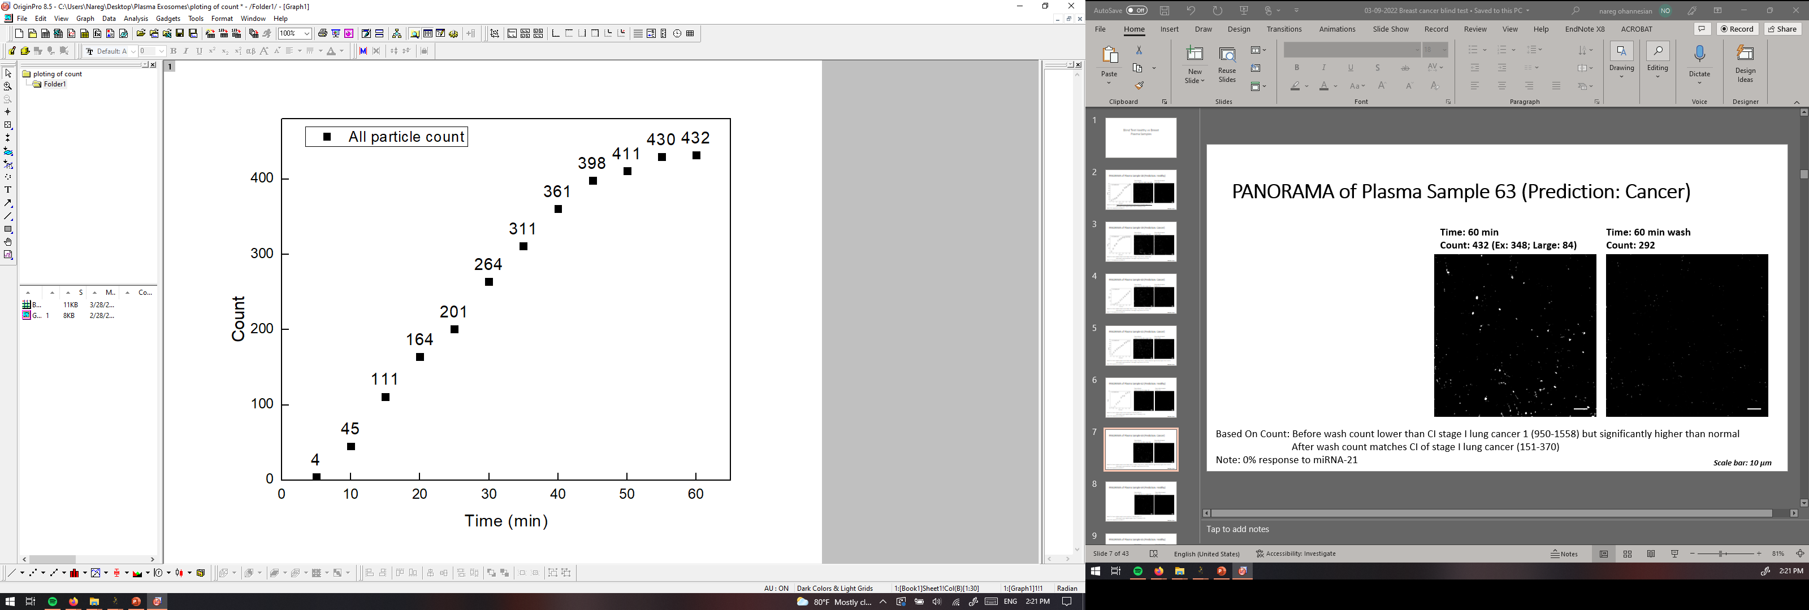
PANORAMA of Plasma Sample 63 (Prediction: Cancer)
Time: 60 min
Count: 432 (Ex: 348; Large: 84)
Time: 60 min wash
Count: 292
Based On Count: Before wash count lower than CI stage I lung cancer 1 (950-1558) but significantly higher than normal
After wash count matches CI of stage I lung cancer (151-370)
Note: 0% response to miRNA-21
Scale bar: 10 µm

Slide 14

PANORAMA of Plasma Sample 64 (Prediction: Healthy)
Time: 60 min
Count: 148 (Ex: 111 ; Large: 37)
Time: 60 min wash
Count: 18
Based On Count: Before wash count matches CI Healthy (64-172)
After wash count slightly higher than CI Healthy (7-28)
Note: 0 % response to miRNA-21
Scale bar: 10 µm

Slide 15
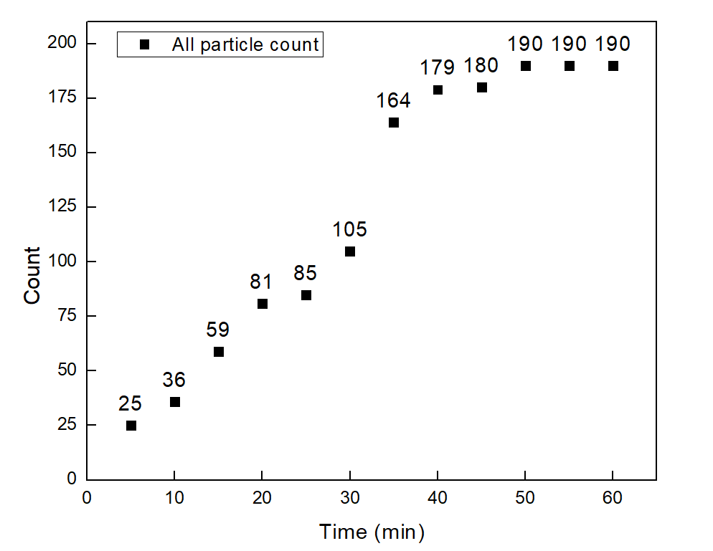


PANORAMA of Plasma Sample 65 (Prediction: Healthy)
Time: 60 min
Count: 190 (Ex: 142 ; Large: 48)
Time: 60 min wash
Count: 10
Scale bar: 10 µm

Slide 16
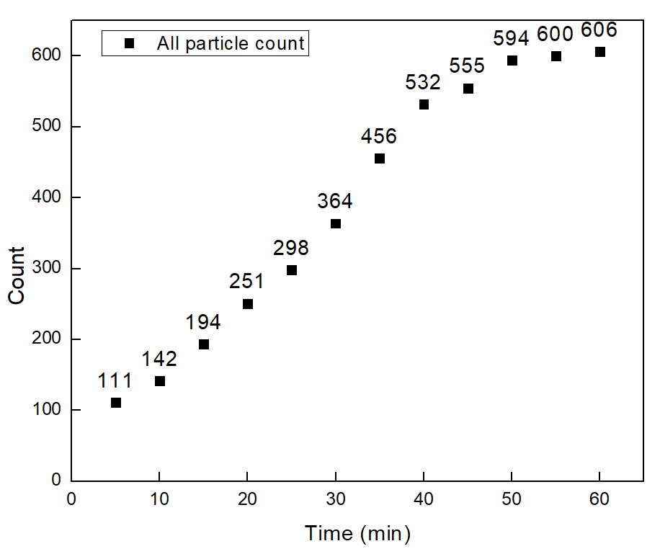


PANORAMA of Plasma Sample 66 (Prediction: Cancer)
Time: 60 min
Count: 606 (Ex: 402 ; Large: 204)
Time: 60 min wash
Count: 224
Based On Count: : Before wash count lower than CI stage I lung cancer 1 (950-1558)
After wash count matches CI of stage I lung cancer (151-370)
Note: 9.5 % response to miRNA-21
Scale bar: 10 µm

Slide 17
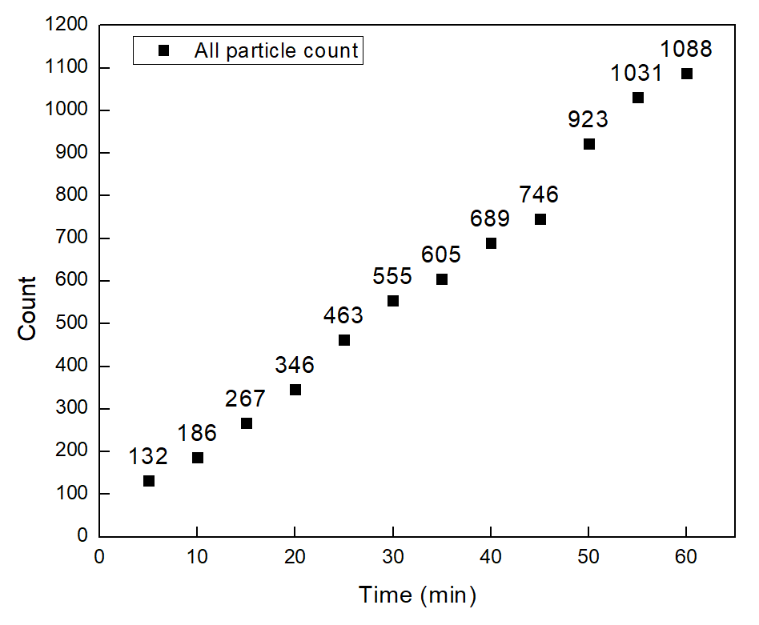
PANORAMA of Plasma Sample 67 (Prediction: Cancer)
Time: 60 min
Count: 1088 (Ex: 918 ; Large: 170)
Time: 60 min wash
Count:196
Based On Count: Before wash count lower than CI stage I lung cancer 1 (950-1558)
After wash count matches CI of stage I lung cancer (151-370)
Note: 19 % response to miRNA-21
Scale bar: 10 µm

Slide 18

PANORAMA of Plasma Sample 68 (Prediction: Cancer)
Time: 60 min
Count: 1420 (Ex: 1079 ; Large: 341)
Time: 60 min wash
Count: 476
Based On Count: : Before wash count lower than CI stage I lung cancer 1 (950-1558)
After wash count higher CI of stage I lung cancer (151-370)
Note: 48 % response to miRNA-21
Scale bar: 10 µm

Slide 19

PANORAMA of Plasma Sample 69 (Prediction: Healthy)
Time: 60 min
Count: 669 (Ex: 194 ; Large: 475)
Time: 60 min wash
Count: 66
Based On Count: Before wash count significantly higher CI Healthy (64-172)
After wash count higher than CI Healthy (7-28)
Note: 0 % response to miRNA-21
Scale bar: 10 µm

Slide 20

PANORAMA of Plasma Sample 70 (Prediction: Cancer)
Time: 60 min
Count: 1314 (Ex: 1134 ; Large: 180)
Time: 60 min wash
Count: 212
Based On Count: : Before wash count lower than CI stage I lung cancer 1 (950-1558)
After wash count higher CI of stage I lung cancer (151-370)
Note: 22 % response to miRNA-21
Scale bar: 10 µm

Slide 21
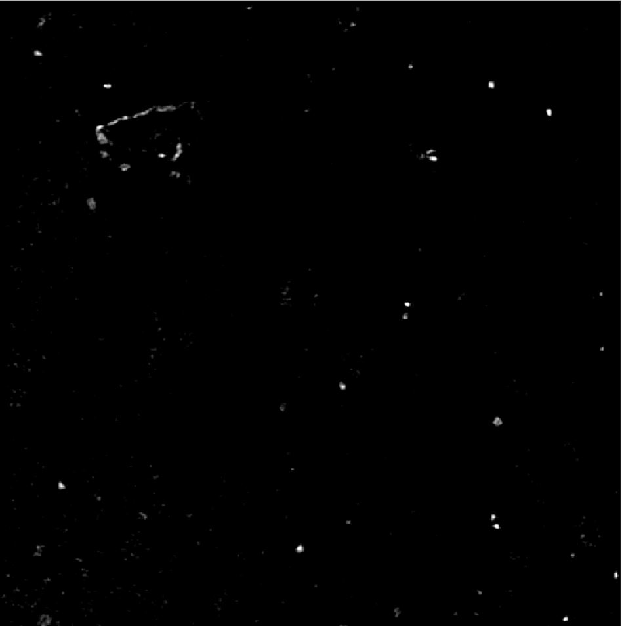

PANORAMA of Plasma Sample 71 (Prediction: Cancer)
Time: 60 min
Count: 199 (Ex: 168; Large: 31)
Time: 60 min wash
Count: 95
Based On Count: Before wash count lower than CI of stage 1 (950-1558)
After wash lower than CI stage 1 (151-370) and
higher than Healthy (5-70)
Note: 0 % response to miRNA-21
Look cancerous
Scale Bar: 10 µm

Slide 22
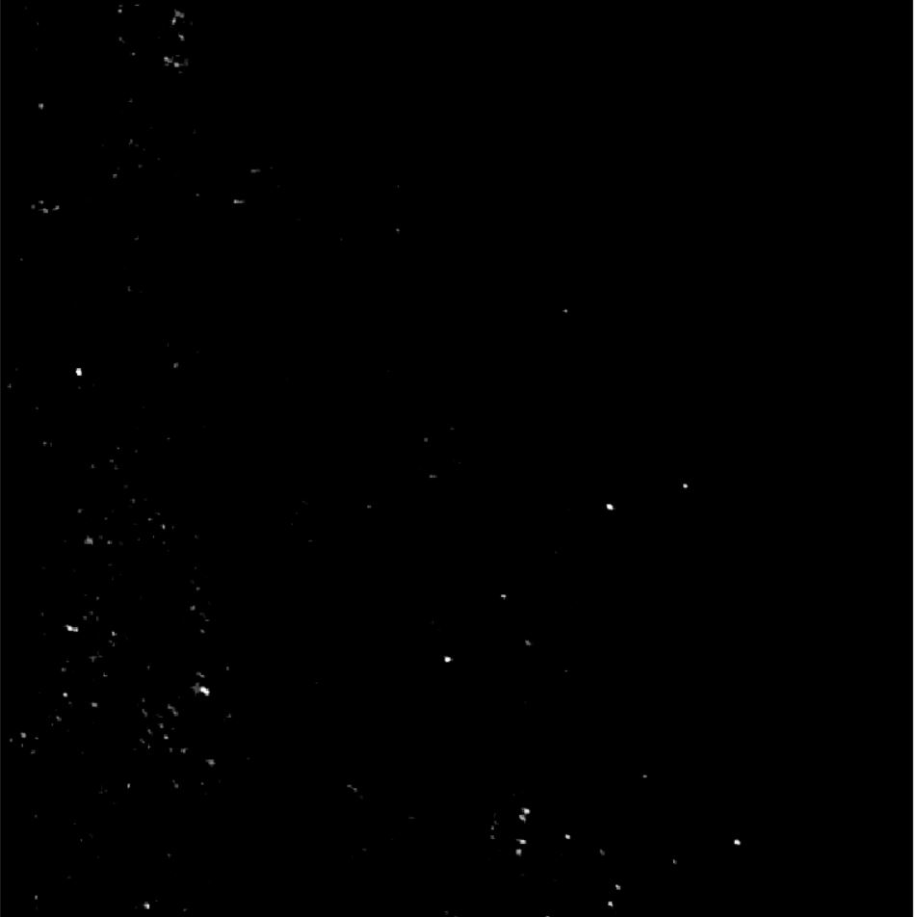

PANORAMA of Plasma Sample 72 (Prediction: Healthy)
Time: 60 min
Count: 138 (Ex: 105; Large: 33)
Time: 60 min wash
Count: 9
Based On Count: Before wash count higher than CI Healthy (64-172)
After wash count matches 99% CI Healthy (5-28)
Note: 0 % response to miRNA-21
Look healthy
Scale Bar: 10 µm

Slide 23
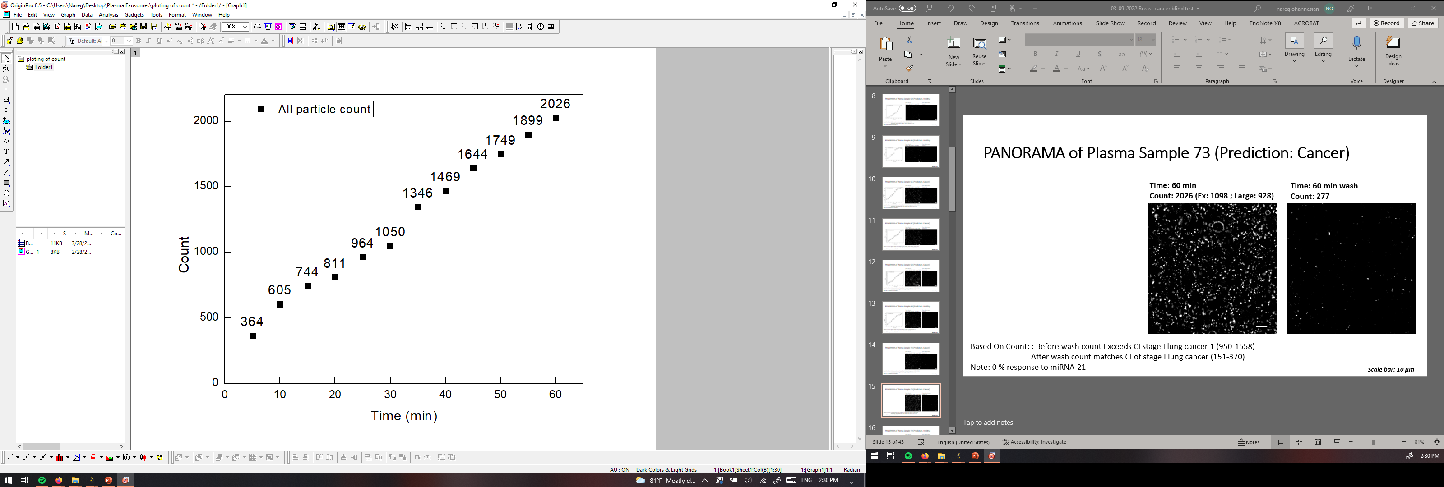
PANORAMA of Plasma Sample 73 (Prediction: Cancer)
Time: 60 min
Count: 2026 (Ex: 1098 ; Large: 928)
Time: 60 min wash
Count: 277
Based On Count: : Before wash count Exceeds CI stage I lung cancer 1 (950-1558)
After wash count matches CI of stage I lung cancer (151-370)
Note: 0 % response to miRNA-21
Scale bar: 10 µm

Slide 24

PANORAMA of Plasma Sample 74 (Prediction: Healthy)
Time: 60 min
Count: 261 (Ex: 171; Large: 90)
Time: 60 min wash
Count: 8
Based On Count: Before wash slightly higher CI Healthy (64-172)
After wash count matches CI Healthy (7-28)
Note: 0 % response to miRNA-21
Scale bar: 10 µm

Slide 25

PANORAMA of Plasma Sample 75 (Prediction: Healthy)
Time: 60 min
Count: 468 (Ex: 123 ; Large: 345)
Time: 60 min wash
Count: 40
Based On Count: Before wash count significantly higher CI Healthy (64-172)
After wash count slightly higher than CI Healthy (7-28)
Note: 0 % response to miRNA-21
Scale bar: 10 µm

